Slide 1
Female Characters in gothic texts

Slide 2
Learning Objectives
To explore the place of women in gothic fiction
To look at the characteristic features of different female characters
To consider some of the ways these characters are presented

Slide 3
Success Criteria
By the end of the lesson you will all be able to comment on the role Lady Macbeth as a female gothic character

Slide 4
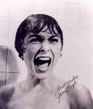
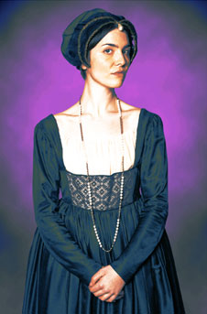
Two types of female character
The trembling and innocent victim
The shameless and dangerous predator

Slide 5
The trembling victim
www.youtube.com/watch?v=CuRQH_hLcTw
Characteristically frail, blonde-haired
A representative of “respectable” society, largely silent, passive and wide-eyed
Gothic-horror has a tendency to position the woman as victim

Slide 6
The trembling victim
Feminist studies have suggested the woman’s occasional sympathy for the monster may represent the exclusion of both from the power structures of conventional society
With any gothic text you read: To what extent are women suppressed or marginalised within the story?

Slide 7
The trembling victim
The trembling victim model often appears in the role of the pursued maiden, fleeing a rapacious and predatory male.
She may also play the traditional role of the trapped princess, awaiting the saviour prince.

Slide 8
The predator
http://www.youtube.com/watch?v=36m2jLl0Me4
Parodied as dark-haired, red-lipped, tight dresses and startling cleavage
Presented more seriously as a dangerous, rapacious creature, offering a real sexual threat.
Such women are often punished for their transgressions.

Slide 9
The importance of the female character
Mario Pratz argued that the rise of the Gothic in the 18th century was precisely due to that period’s “feminine character”
Three Gothic Novels (1968)

Slide 10
It has been argued that the stories play out a battle of the sexes, that they explore the uneasy relationship between pain and love, that the mother-figure is a hugely significant presence – or absence
In Frankenstein the eponymous hero effectively usurps the maternal role of the female in his bringing the creature to life. The women in the novel seem largely helpless creatures, both in terms of the influence they have on others and in their attempts to protect themselves.

Slide 11
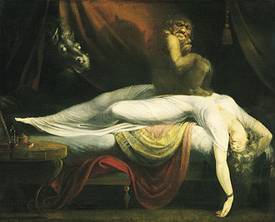

Slide 12
The expression of feeling
It has frequently been suggested that an important role of the females in gothic texts is to express feelings, often as a means of heightening terror.
Read the extract from Wuthering Heights. In what ways does Catherine express her feelings in the extract? What other gothic elements are present?
Now read the extract from Frankenstein and do the same activity

Slide 13
Female stereotypes and ambivalence of response
Not all pursuits are performed by men. It is hard to view Catherine as a merely passive victim of circumstance. Our response to her predicament is likely to be ambivalent.
The pursued maiden in gothic narratives is balanced by the femme fatale.

Slide 14
Female stereotypes and ambivalence of response
Threatening and dangerous women are a staple part of vampire stories and bring with them unsettling images of sexual aggression and illicit desires.
Gothic authors are often able to use female characters as a means of exploring material otherwise off limits.

Slide 15
Female stereotypes and ambivalence of response
It is possible to view the flight of gothic maidens as a fantasy of escape from constraints within a paternalistic world.
Similarly, dangerous female characters of gothic texts might represent emancipated women, no longer prepared to conform and submit to male control.

Slide 16
Female stereotypes and ambivalence of response
At times ambivalence, or uncertainty, can be a very significant part of the threat offered by female gothic characters.
Read the passage from Macbeth and consider the significance of the presentation of the female characters.

Slide 17
Female stereotypes and ambivalence of response
Read the description of the vampires from Bram Stoker’s novel Dracula (1897) and identify what seem to you to be significant features of their presentation.
Look carefully at the nouns that dominate the description
How are the feelings and desires carefully balanced here, and what does this tell us about the effects of the vampires on the narrator?

Slide 18
The mother figure
The dominating father is a key presence in Gothic, the monstrous mother also plays a part in some gothic narratives
www.youtube.com/watch?v=NG3-GlvKPcg
They are often presented in such a way as to challenge the stereotypical image of a mother as a comforting, protective figure.
www.youtube.com/watch?v=S14wY6TG6Cw

Slide 19
Explore the role and presentation of Lady Macbeth

